Slide 1



CONTENTS
ABSTRACT
IMPLEMENTATION
MOTIVATION
DATASET AND ITS FEATURES
METHODOLOGY
IMPLEMENTATION
PERFORMANCE MEASURES
RESULTS
CONCLUSION
PAPERS PUBLISHED

Slide 2

ABSTRACT
Diabetes has become a prevailing disease to the mankind from young to the old.
There is a rapid increase in the growth of diabetic patients due to various causes such as bacterial or viral infection, toxic or chemical contents mix with the food, auto immune reaction, obesity, bad diet, change in lifestyles, eating habit, environment pollution, etc.
Many complications occur if diabetes remain untreated and unidentified. Hence, diagnosis of the disease is very crucial to save the human life from diabetes.
Data Analytics is a process of examining and identifying the hidden patterns from large amount of data to draw conclusions. In Medical care, this analytical process can be carried out using machine learning algorithms for analyzing medical data to build the machine learning models in order to carry out medical diagnoses.
The motive of this study is to explore the approaches to improve the accuracy in the prediction of diabetes using medical data with various machine learning algorithms and methods. Thus, four machine learning classification algorithms namely Naïve Bayes, Decision Tree, SVM and Random Forest are used in this study for the detection of diabetes at early stages.

Slide 3

INTRODUCTION
Diabetes is a chronic disease caused by the increase in blood sugar, mainly due to less production or no production of insulin in body(type1 diabetes) , or due to the fact that cells do not respond to the produced insulin(type2 diabetes) and is often called as a contemporary-society disease because widespread lack of regular exercise and rising obesity rates are some of the main contributing factors for it . There are three types of diabetes:
B. Type-2 Diabetes
C. Gestational Diabetes
Type-1 Diabetes

Slide 4
MOTIVATION
“Prevention is always better than cure” but not always people who are affected are aware of it.
One third of the diabetic patients are not even aware of the disease until they reach the middle stages.
Proper medical checkups and awareness might help them in recognizing their symptoms beforehand. Thus, reducing the severity of the situation.
Some of the common symptoms of diabetes are as follows:
Excessive thirst and hunger
Frequent urination
Weight loss or gain
Fatigue
Irritability
Blurred vision
Slow healing wounds
Nausea
Skin infections

Slide 5
Issues related to diabetes:
People with type-2 diabetes are mostly addicted to insulin to maintain sugar levels but excess of insulin decreases the metabolism of body.
Sudden decrease in blood levels and glucose levels can cause death.
Using medicines does not cure diabetes as such proper diet should be maintained.
If a person affected with diabetes also has any other disease it is not cured due to power of this dreadful disease.
Many techniques have been discovered to find the causes of diabetes and cure it. To increase the awareness of the disease priorly a diabetic predicting technique should be implemented which solves the above problems to some extent. To implement the technique, we use machine learning algorithms that can predict the approximate number of diabetic patients. Along with machine learning algorithms, data mining is also used to maintain the large amount of data.

Slide 6
DATASET AND ITS FEATURES
This dataset is originally from the National Institute of Diabetes and Digestive and Kidney Diseases. The objective of the dataset is to diagnostically predict whether or not a patient has diabetes, based on certain diagnostic measurements included in the dataset. In particular, all patients here are females at least 21 years old of Pima Indian heritage. PIDD- Pima Indian Diabetes Dataset
The proposed system is carried out on Diabetes Dataset namely (PIDD), which is taken from UCI Repository. This dataset consists of 768 instances of female patients here are at least 21 years old of Pima Indian heritage.
The dataset comprises of numeric valued 8 attributes where value of one class ’0’ is tested negative for diabetes and value of another class ’1’ is tested positive for diabetes
Table 1: Dataset Description
Dataset | Number of Parameters | Number of Samples
PIDD | 8 | 768

Slide 7
FEATURES IN PIMA INDIAN DIABETES DATASET
Feature in data | Description | Type
Pregnancies | A record of the number of times the patient pregnant. | Numeric
Plasma glucose | Plasma glucose concentration measured using a two-hour oral glucose tolerance test (mm Hg) | Numeric
BP | Blood Pressure | Numeric
ST | Skin Thickness(mm) | Numeric
Insulin | Two-hour serum insulin (mu U/ ml) | Numeric
BMI | Body mass index (weight Kg/height in (mm)2 | Numeric
DPF | Diabetes pedigree function | Numeric
Age | Age of the patient (years) | Numeric
Outcome | Whether the patient will be affected with diabetics or not. | Nominal

Slide 8
SAMPLE DATASET
S.no | pregnancies | PG | BP | ST | Insulin | BMI | DPF | Age | Outcome
1 | 6 | 148 | 72 | 35 | 0 | 33.6 | 0.627 | 50 | 1
2 | 1 | 85 | 66 | 29 | 0 | 26.6 | 0.351 | 31 | 0
3 | 8 | 183 | 64 | 0 | 0 | 23.3 | 0.672 | 32 | 1
4 | 1 | 89 | 66 | 23 | 94 | 28.1 | 0.167 | 21 | 0
5 | 0 | 137 | 40 | 35 | 168 | 43.1 | 2.288 | 33 | 1
6 | 5 | 116 | 74 | 0 | 0 | 25.6 | 0.201 | 30 | 0
7 | 3 | 78 | 50 | 32 | 88 | 31 | 0.248 | 26 | 1
8 | 10 | 115 | 0 | 0 | 0 | 35.3 | 0.134 | 29 | 0
9 | 2 | 197 | 70 | 45 | 543 | 30.5 | 0.158 | 53 | 1
10 | 8 | 125 | 96 | 0 | 0 | 0 | 0.232 | 54 | 1

Slide 9
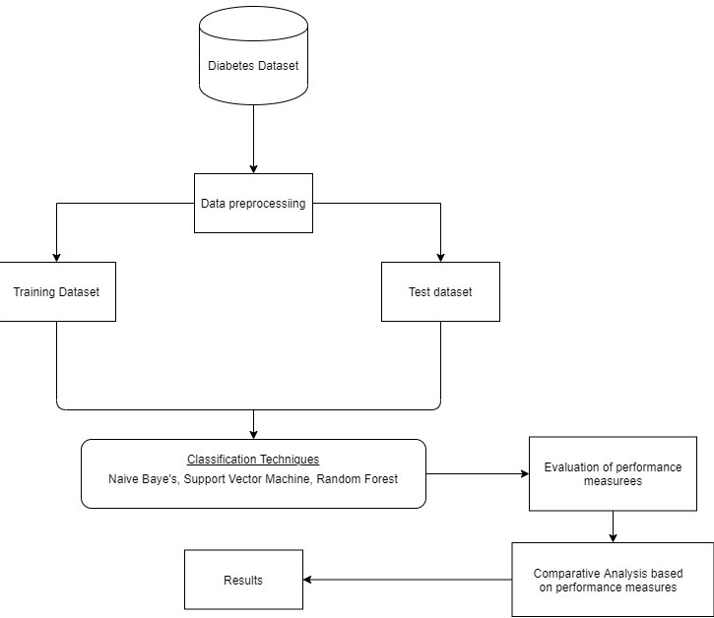
METHODOLOGY
The proposed model diagram is presented in the figure below. This framework presents the sequence and flow of the experimental process followed in this work.

Slide 10
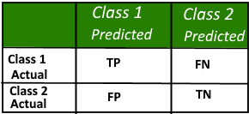
CONFUSION MATRIX:
A confusion matrix is a summary of prediction results on a classification problem.
The number of correct and incorrect predictions are summarized with count values and broken down by each class. This is the key to the confusion matrix.
Positive (P): Observation is positive (for example: is an apple).
Negative (N): Observation is not positive (for example: is not an apple).
True Positive (TP): Observation is positive and is predicted to be positive.
False Negative (FN): Observation is positive but is predicted negative.
True Negative (TN): Observation is negative and is predicted to be negative.
False Positive (FP): Observation is negative but is predicted positive.

Slide 11
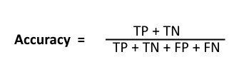



PERFORMANCE MEASURES
ACCURACY
A simple ratio between the number of instances correctly predicted to the total number of instances used in the observation, in other words, accuracy gives the percentage of correctly predicted instances.
RECALL
A measure that provides for each class the ratio between the true positive instances predicted and the sum of true positives and false negatives in the observation.
F-measure
The weighted average of Precision and Recall and it's considered perfect when it´s 1.0 and the worst possible value is 0.0, so a good F1 score means that we have low false positives and low false negatives.
PRECISION
A measure that provides for each class the ratio between correctly positive predicted instances and total of positive instances predicted.

Slide 12
IMPLEMENTATION
1
1.We imported libraries such as Pandas, Numpy, Sklearn, Matplotlib, Seaborn
Pandas : used to deal with data analysis and manipulation
Numpy: used to perform mathematical and logical operations on arrays
Sklearn: It is a free machine learning library for Python which features various algorithms like svm, random forest etc.
Matplotlib & Seaborn : used for visualization of data.
2.The data is imported from Pima Indians Diabetes dataset from the UCI repository import the data file using pandas read function.
3.Now the data is checked for any null and missing values using isnull().any() function from pandas and found no null values.

Slide 13
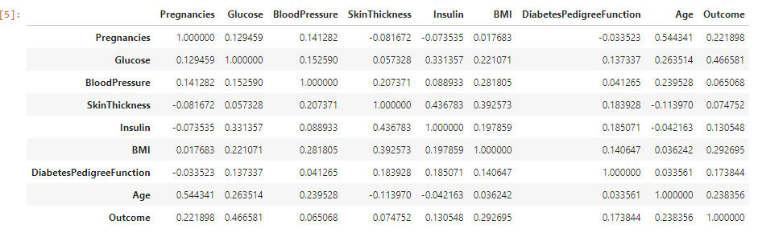
4. To find out best features, correlation between parameters and outcome is calculated using corr() function from pandas.
5.The dataset is split into two sets i.e., features set(X) and outcome(Y).
6.The resultant dataset is further split into Xtrain, Ytrain, Xtest, Ytest with the test size of 0.25 using Sklearn.
7.The training dataset is used for building the model and testing dataset is used to find out the model’s performance.
8.A set of classification models are identified for this work and selected best model based on performance metrics (Accuracy , Recall ,f1-Score, Precision).
9.The candidate classification models used here are Naive Bayes classifier, Support Vector Machine, Decision Tree and Random Forest.
10.Performance metrics were measured for each model in order to increase the performance of models, we carried out the Hyper tuning of each model, except for Naive bayes (since this model not facilitated for hyper tuning).

Slide 14
12.Using Grid search method, we find out best hyper parameters for each model and measured performance metrics with these hyperparameters.
13.Assessing the models based on various performance metrics with & without hyper tuning.
14. By comparing the models based on the various performance metrics and select the best Classification model to predict diabetes person
15.The performance evaluation of the classification models based on the metrics are represented graphically.

Slide 15
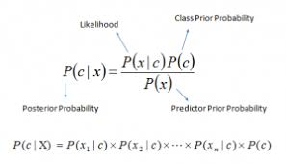
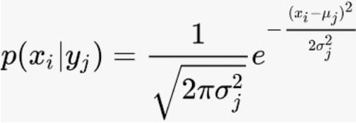
Description of Algorithms used:
1. Naïve Bayes
Naive Bayes is a classification technique with a notion which defines all features are independent and unrelated to each other. It defines that status of a specific feature in a class does not affect the status of another feature. Since it is based on conditional probability it is considered as a powerful algorithm employed for classification purpose. Naive Bayes is a machine learning classifier which employs the Bayes Theorem.

Slide 16
[TP=38 FN=36
FP=19 TN=138]
The accuracy is 0.7619

Slide 17
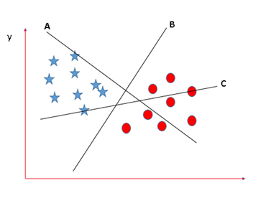
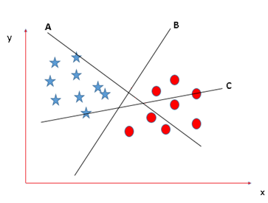
2. Support Vector Machine(SVM)
“Support Vector Machine” (SVM) is a supervised machine learning algorithm . In this algorithm, we plot each data item as a point in n-dimensional space (where n is number of features we have) with the value of each feature being the value of a coordinate. Then, we perform classification by finding the hyper-plane that differentiate the two classes very well.
Scenario-1: Scenario-2:

Slide 18
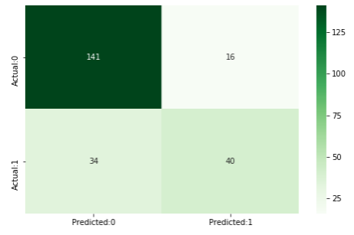
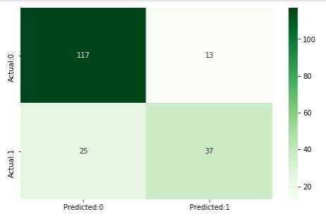


[TP=40 FN=34
FP=36 TN=141]
The accuracy is 0.7835
Hyper Tuning
The Best Obtained parameters using grid search are
Now , the accuracy is 0.8020

Slide 19
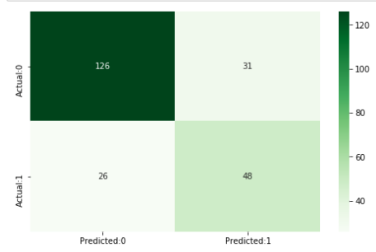
3. Decision Tree Classifier
Decision Tree is a supervised machine learning algorithm used to solve classification problems. The main objective of using Decision Tree in this research work is the prediction of target class using decision rule taken from prior data. It uses nodes and internodes for the prediction and classification. Root nodes classify the instances with different features. Root nodes can have two or more branches while the leaf nodes represent classification.
[TP=48 FN=26
FP=31 TN=126]
The accuracy is 0.7359

Slide 20
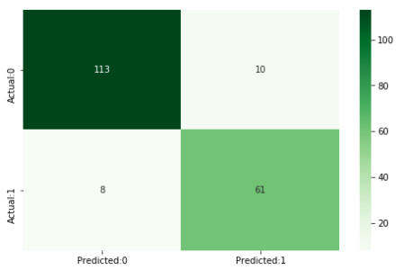

Hyper Tuning
The Best Obtained parameters using grid search are
Now , the accuracy is 0.9062

Slide 21
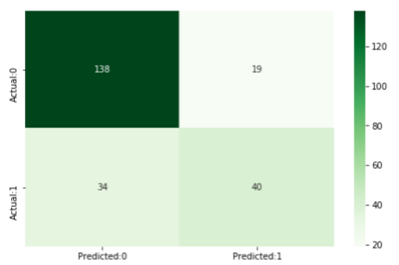
4. Random Forest
Random forest is a supervised machine learning algorithm which is used for both regression \ as well as classification. Similarly, random forest algorithm generates decision trees on samples of data and then gets the prediction from each of the tree and finally selects the best result. It is an effective method which is better than a single decision tree because it reduces the over-fitting by averaging the result.
[TP=40 FN=34
FP=19 TN=138]
The accuracy is 0.7705

Slide 22
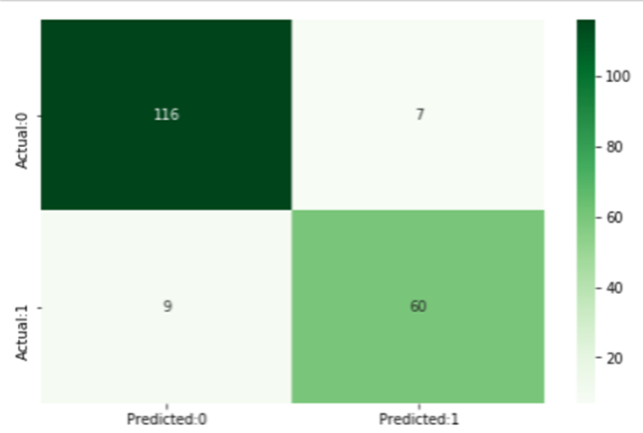
Hyper Tuning
The Best Obtained parameters using grid search are
Now , the accuracy is 0.9166

Slide 23
RESULTS
Comparative performance of classification Techniques on various measures.
Algorithms | Precision |  | F1-score |  | Accuracy % |  | Recall
 | WH | WOH | WH | WOH | WH | WOH | WH | WOH
Naive Bayes |  | 0.66 |  | 0.58 |  | 76.2 |  | 0.51
SVM | 0.74 | 0.71 | 0.66 | 0.61 | 80.20 | 78.3 | 0.59 | 0.54
Random Forest | 0.89 | 0.67 | 0.88 | 0.60 | 91.66 | 77.0 | 0.86 | 0.54
Decision Tree | 0.85 | 0.60 | 0.87 | 0.62 | 90.62 | 73.0 | 0.88 | 0.64
WH-With Hyper tuning WOH-With out Hyper tuning

Slide 24
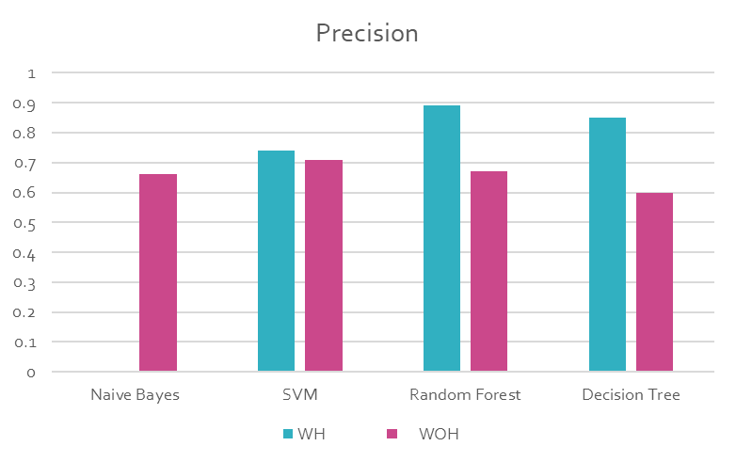
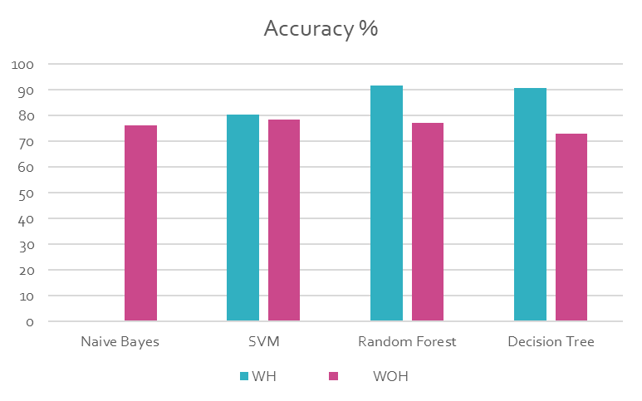
Graphs for various performance measures:
a) Precision b) Accuracy

Slide 25
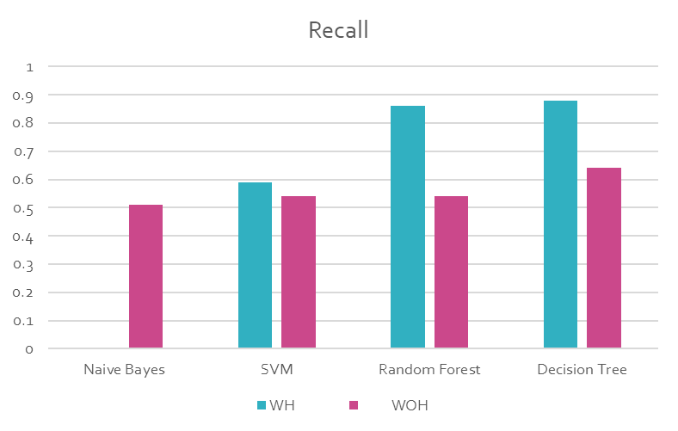
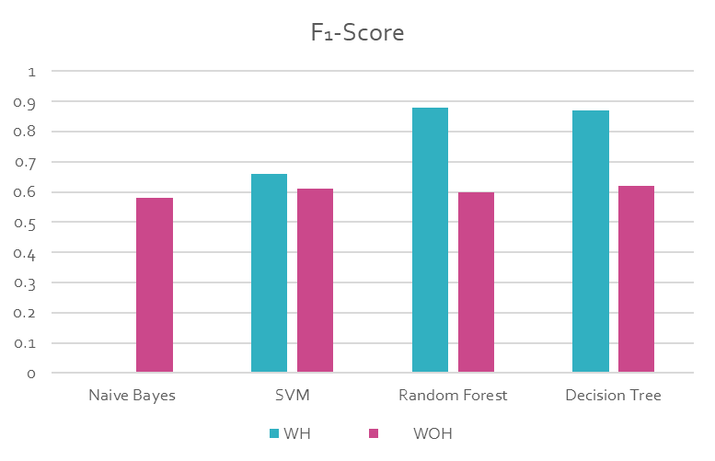
c) Recall
d) f1_score

Slide 26
CONCLUSION
One of the most crucial real-life medical problems is the identification of diabetes at its early stage. In this experiment, systematic efforts are made in developing a system which in turn results in the prognostication of dreadful disease like diabetes. During this experiment, four machine learning classification techniques are studied and evaluated on various performance measures. Pima Indians Diabetes Database(PIDD) is used in order to perform experiments. Results of the proposed study determine the adequacy of the designed system with highest accuracy of 91.66 % using the Random forest classification technique. In future, the developed system with the used machine learning classification techniques can be used to predict other diseases. In future, extension and improvement can be made in the automation of diabetes analysis with the help of various other supervised machine learning algorithms.

Slide 27

THANK YOU

